Slide 1

Building a Safety Culture
Through Effective Engagement of Line Staff
Joanne Locke, RN, JD
Former Director, Risk Management and Clinical Compliance
Brigham and Women’s Faulkner Hospital
joannelockejd@gmail.com
Karen Fiumara, PharmD
Executive Director, Patient Safety and Risk Management
Brigham and Women’s Hospital
Mass Coalition
Patient Safety Forum
May 4, 2018

Slide 2

Legal, Regulatory, and Policy
Requirements Related to Medical Error
Federal/state statutes and regulations
  Massachusetts Department of Public Health
    Serious Reportable Events
  Massachusetts BORM QPSD Division
    Safety and Quality Reports (SQRs)
  The Joint Commission
    Culture of Safety
Hospital policies and Initiatives
  IC, Pt Rights, Code of Professional Conduct, Disclosure and Apology
Distinction between regulators and internal review

Slide 3
Overview
Introduction
  What we expected v. what we found
BWFH Case for Change
  Safety Culture Survey Results of 2014
  CRICO Risk Assessment Program of 2014
Strategy Development
Organization, Roll-out, Integration
Safety Culture Survey Results 0f 2016

Slide 4
BWFH CRICO RAPP
Strengths:
  Strong clinical and non-clinical leadership that are committed to, engaged in, and supportive of patient safety activities. Evidence of a commitment to patient safety activities and strong engagement of line staff.
  Overall, the CRICO RAPP found that BWFH is,
    “...well on its way toward being a highly reliable, and transparent provider of excellent patient care.”
4

Slide 5
BWFH CRICO RAPP
Challenges:
  A strong disparity between the leadership perception of
    High morale
    Robust communication
    Open feedback
  Line staff belief that leadership lacked appreciation of contributors to error, affecting staff’s willingness to report
    Job requirements
    Production pressure
    Reimbursement
    Lack of standardized response to error
5

Slide 6
Strategy Development
2014 Safety Culture Survey/RAPP Results
  Leadership Review and Analysis: serious self-examination
  Line staff concerns
    Line staff perceived a negative impact of reporting errors, a punitive response to error, and inconsistent leadership responses
Goal Development:
  Department-specific strategies to understand and respond to staff concerns r/t feeling safe to report errors
  Create an environment to respond consistently to errors in a fair and just manner.
  Introduce methodology to build a strong culture of safety hospital-wide

Slide 7
BWFH Collaborative Just Culture Program
Education and Training
  Introduction Training: Supervisory Staff
  Advanced Training: Champions
  Video Introduction Presentation: Direct Care and Support Staff Members
  Interdisciplinary Just Culture Steering Committee: 35 Members
Customization of Collaborative Case Reviews (CCRs) (formerly known as RCAs)
  Systems Focused Reviews of the Events
  Risk Assessment Worksheet for Directors and Supervisors
  CCR Highlights Presentations/Follow-Up : Monthly /Leadership/Committee Meetings
Leadership Support
  Senior Leadership Training: President, VPs, Chiefs, Service Line Chiefs, NPs
  Customized Physician Training for Medical Staff Peer Review Committee
  Monthly leadership case presentation and regular newsletter articles
Integration of Just Culture Principles into Safety Reporting System
  Feedback and Communication About Safety Events, specific changes within system to create triage for Just Culture review and staff support, and use reporting data to trend system issues and corrective actions
Clarification of the term ”Just Culture”

Slide 8
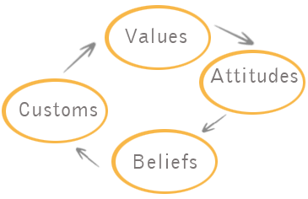
What is a Culture of Safety?
A culture of safety is a culture where:
  We are curious, rather than critical, about why errors occur
  Each of us feel a personal commitment to safe care.
  We are encouraged
  to be open about our
  errors and the system
  vulnerabilities we see.
  We all feel comfortable
  speaking up/reporting concerns.
  It’s all about risk, not fault.

Slide 9

How Does a Safe Culture Improve Care?
We can fix only what we know
We see only the errors that break the surface and result in harm
There is more risk lurking just below the surface, which the front line can help identify and manage…
Front line staff have the most knowledge about errors and insight about causes and solutions, but do they feel safe enough to tell us?

Slide 10
Safety Culture and High Reliability
HR Framework
  Risk identification, system development, behavior and performance, sustainment
Challenges of building HROs in healthcare
  Safety is never the only value
    Production, customer service, finances
  Difficult to accept anticipation of human failure
  No integrated/cross-functional regulation
  Sustainment efforts require long-term view

Slide 11
How BWFH Defined “Just Culture”
Framework for REDUCING FUTURE RISK, by evaluating our systems and behaviors to identify and mitigate vulnerabilities
  Sometimes the risk is in our system, sometimes it is in our behaviors, and often it is in both
  Important to start with the system, not the individual
  Not outcome driven (left of BANG, not right)
Guides us in how to respond to employee behaviors in a fair, just, and collaborative way
  Just Culture is not about finding fault, it is about managing future risk. We want to move away from shame and blame and create a culture of continuous learning by being curious, not critical

Slide 12
Leadership Accountability for Safety
Leadership is accountable for:
  Creating effective and resilient systems within their capabilities– zero error is an aspirational goal
  Listening to employee safety concerns
  Setting clear expectations
  Responding to employee behaviors in a fair, just, and collaborative way
    Understand the context of choices and error; remove “red line” policies
    Look beyond the error for future risk mitigation and improvement
    Clearly communicate priorities when values conflict
    Provide regular feedback and coaching to improve systems.

Slide 13
Shared Accountability for Safety
All employees are accountable for:
  The quality of our choices
  Reporting issues and vulnerabilities
  Speaking up – what we don’t correct, we condone
    Saying nothing is saying “Yes”
  Participating in solutions to mitigate future risk
  Leadership must be careful to look for system contributors to behavioral choices

Slide 14
System Analysis of Adverse Events
Identify the risk (s)
  The severity and the likelihood of occurrence
  What are the competing priorities?
    Patient safety, production, efficiency, finance
  Awareness of overt/covert messaging to staff
If current system is used as designed, is it effective in managing risk and resilient to vulnerabilities?
  Will it adversely affect other critical operations?

Slide 15
Analysis of Employee Behaviors
Were employer’s expectations clear?
Was there a clear policy, procedure, practice?
Was it possible for the ee to follow the p/p/p?
Did the employee choose not to follow it?
If so, did the employee not recognize the risk or mistakenly feel justified in not following p/p/p?
Was there conscious disregard of p/p/p?

Slide 16
Ask These Questions
During a Case Review…
What happened?
Did what happened differ from what we expected?
Carefully examine the system in which the employee works.
(deviation from “right way to do it” as per standard of
care/guidelines/established process?) Avoid outcome bias.
Has the institution clearly communicated the employer’s expectations?
(What did the employee understand to be “the right way to do it”?)
What was the behavior that accounted for the deviation and what drove the behavior?
  Behavior: Inadvertent vs. choice?
  How your managers approach this analysis with employees will determine the success or failure of engaging line staff in this process.
  Remember: the goal is to view the event with curiosity, not criticism because the goal is to reduce future risk.
  What factors drove the behavior? Did the system contribute or drive the behavior?
  Was the employee alone in this deviation, or would others in the peer group make similar choices?
How do we respond?
  To the system?
  To the employee involved?
  To other employees?
  Do we address factors that increase likelihood of inadvertent errors?
  Do we reconcile competing priorities and decide how to respond?
  Do the employee and institution share the burden of accepting risk when additional resources are not available?

Slide 17
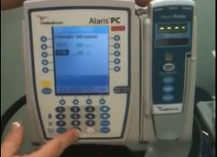
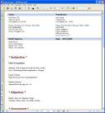

In a Just Culture We
Evaluate the Behavior, Not the Outcome
1
Have we effectively communicated the behavioral expectations?
Human Error
At-Risk Behavior
Reckless Behavior
Inadvertent Act
“Could happen to anyone”
Choice: Risk Believed Insignificant/Justified
“Others might do
the same”
Choice: Conscious Disregard of Substantial and Unjustifiable Risk
“That is
unacceptable”
What is the behavior? (in context of system)
2
What is the response?
Console
3
Coach
Corrective action

Slide 18
…Then Address Underlying
Factors Leading to Behavior (not outcome).
Human Error
At-Risk Behavior
Reckless Behavior
Human Error
At-Risk Behavior
At-Risk Behavior
Inadvertent Act
Choice: Risk Believed Insignificant/Justified
Choice: Conscious Disregard of Substantial and Unjustifiable Risk
How did SYSTEM contribute?
(stress, fatigue,
equipment, lighting)
Was there an UPSTREAM CHOICE that increased risk of error?
What COMPETING PRIORITIES drove choice?
Did SYSTEM create competing priorities?
Check with Peer Group
Confirm that behavioral expectations and consequences of not following expectations were clearly communicated

Slide 19

Human Error
Human Error is not a “Cause,” it is a consequence associated with other factors:
  Were there personal performance factors, like fatigue, distraction, or environment that contributed?
  Did the system contribute to the employee’s choice?
  Did the person make an at-risk choice that increased the possibility that an inadvertent error might occur?

Slide 20

At-Risk Behavior
Our largest bucket
Why? We don’t see the risk
We “think we’re safe”
  Managing competing priorities
  Short on resources, staffing
  Unusual or difficult circumstances
  Shortcuts, cutting corners
  Staff never had a undesired outcome with work-around
  Lack of “good” rule enforcement
  New workers see and adopt “routine” violations

Slide 21
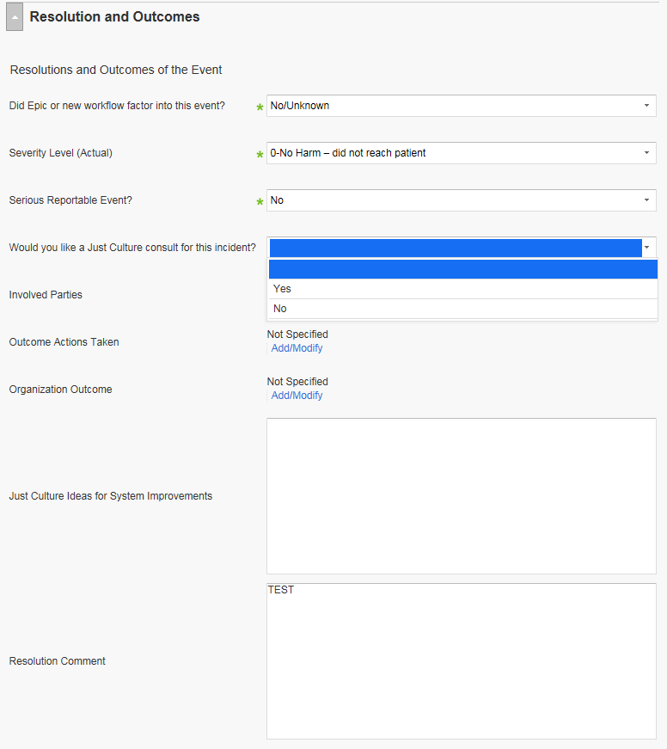
Just Culture in Safety Reporting

Slide 22
Triaging Collaborative Just
Culture Consult Requests
“Would you like a Just Culture Consult for this Incident?”
Response: Yes
Initial triage review by Risk Management/Patient Safety. This will lead to a call to the Director /Manager in area where event reported
Consult on work with staff involved
Includes staff from: Just Culture Committee, Human Resources, & Director/Manager involved
Review of algorithm
Includes staff from: Just Culture Committee & Director/Manager involved
Collaborative Case Review
Includes staff from: Just Culture Committee, Risk Management, Director/Manager and key staff involved
Risk Management/Patient Safety will add any system improvement ideas into the RL field “Just Culture ideas for system improvements”
Trended Just Culture data!

Slide 23
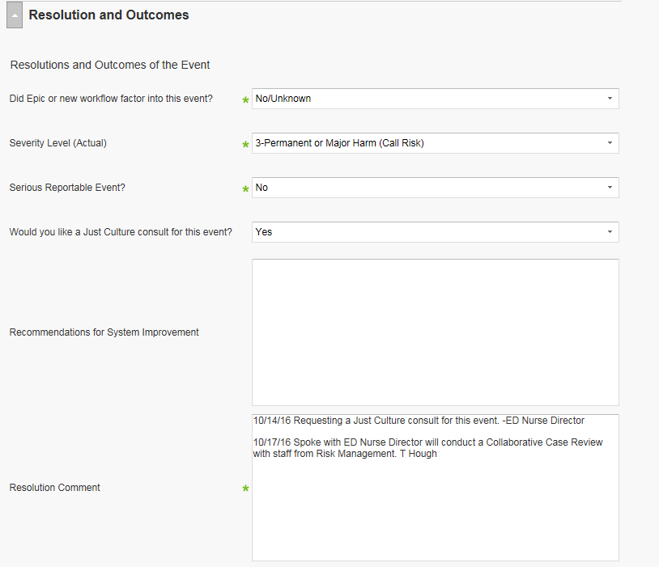
Patient Safety Follow-Up

Slide 24
Collaborative Case Reviews:
Using Context to Find Common Themes
Dietary aide fails to check 2 patient identifiers before leaving tray in patient’s room and gives wrong tray to patient
Security Officer declines to voice his concern to RN about current monitoring plan regarding risk of elopement
Transporter defers to RN’s request to cancel patient transport to a test despite transporter’s concerns that RN is wrong
RN doesn’t pursue concerns with MD about risk about potential staff injury from patient assault regarding MD’s plan for managing an escalating patient
Circulator doesn’t complete debrief at the end of procedure and miscounts specimens

Slide 25
Appreciating the Power Gradient
What is the Authority/Power Gradient?
  Aviation term
    Describes a factor that negatively affects communication between two members of a team who hold different positions in the hierarchy
  Perceived differences in authority/power may inhibit an individual from questioning or challenging another viewed to be in a more senior position
  Power gradients may contribute to adverse events, decrease reporting and increase the potential harm to staff and patients

Slide 26
Embed Customized Process
Improvement Intervention
Problem Scope
Approach
Large complex problems, often multi-disciplinary or multi-departmental
Work-Out
Facilitated Session
Work-Out
PI team facilitator may be requested with sponsor approval
Local project
Local project
Project team led by manager; PI training classes and coaching available
Medium size problems, within a single department
Dept. focus
Dept. focus
Dept. focus
Local project
Local project
Dept. focus
Small problems with simple, easy to implement solutions
Just-Do-Its or PDSA rapid cycle testing by 1-2 staff; PI consultation available
Everyday Improvement
adapted from Liker JK, The Toyota Way Fieldbook

Slide 27
The Work Continues
New Goals
Ongoing Goals
Sustainment strategies
Stronger HR involvement
Enhance role of Advisors
Strengthen supervisor risk assessment skills
Accountability for pilots, f/up
Comprehensive review of “red line” policies; always review rules in the context of violation
Development of hospital policies consistent with methodology
Integrate Just Culture principles within HR policies
Continued engagement and recognition of support staff
Deepen supervisor case review skills to examine systems and behaviors algorithm

Slide 28
The AMC Perspective: Focus on Reliability Management System
Start at the end – Focus on long term goal of having robust high reliability system and safety culture
Be Patient – change takes time
Focus on Key Integrations and structural steps first
  Safety and Risk groups
  Key Partnerships:
    HR
    Clinical Departments – integration with M&M
    Nursing and allied health
    Professionalism and Peer Support
We must see and understand risk
  development of comprehensive “Risk Register”

Slide 29
Thank You!
Questions?

